Slide 1
Econ 100 Principles of Economics
Lecture 19
May 10

Slide 2
Today?
Inflation
Next assignment on next Wednesday after interest rates

Slide 3
INFLATION

Slide 4
Measuring the Cost of Living
Inflation refers to a situation in which the economy’s overall price level is rising.
The inflation rate is the percentage change in the price level from the previous period.

Slide 5

Australia
Inflation target: 2-3%
current inflation rate: 7%
IMF's 12m forecast rate: 4.8%

Slide 6
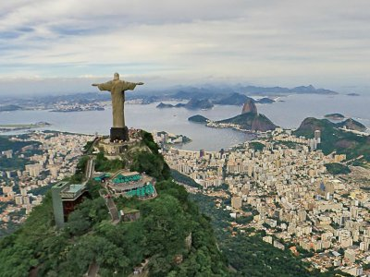
Brazil
Inflation target: 3.75% +/-1.5%
Current inflation rate: 4.65%
IMF's 12m forecast rate: 4.7%

Slide 7

China
Inflation target: 3.0%
Current inflation rate: 0.7%
IMF's 12m forecast rate: 2.2%

Slide 8

India
Inflation target: 4%+/-2.0%
Current inflation rate: 5.66%
IMF's 12m forecast rate: 5.1%

Slide 9
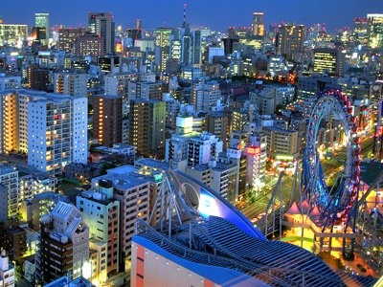
Japan
Inflation target: 2%
Currrent inflation rate: 3.2%
IMF’s 12m forecast rate: 1.4%

Slide 10

Turkey
Inflation target: 5% +/-2.0%
Current inflation rate: 43.68%
IMF's 12m forecast rate: 51.2%

Slide 11

United States
Inflation target: 2.0%
Current inflation rate: 5.0%
IMF’s 12m forecast rate: 3.5%

Slide 12
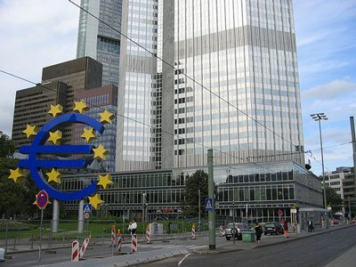
EuroArea
Inflation target: <2%
Current inflation rate: 8.4%
IMF's 12m forecast rate: 2.8%

Slide 13
THE CONSUMER PRICE INDEX
The consumer price index (CPI) is a measure of the overall cost of the goods and services bought by a typical consumer.
Tüketici Fiyat Endeksi (TÜFE)
Türkiye İstatistik Kurumu (TÜİK) reports the CPI (TÜFE) each month.
We use the CPI (TÜFE) to monitor changes in the cost of living over time.

Slide 14
THE CONSUMER PRICE INDEX
When the CPI rises, the typical family has to spend more money to maintain the same standard of living.

Slide 15
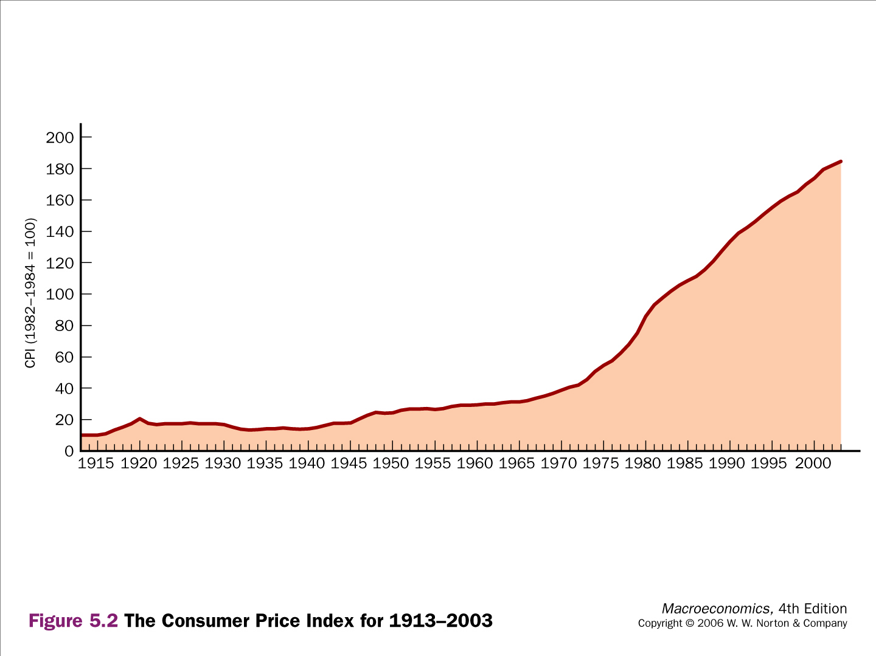
Consumer Price Index - US

Slide 16
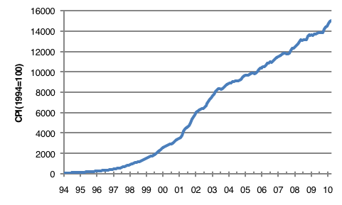
Consumer Price Index - Turkey

Slide 17
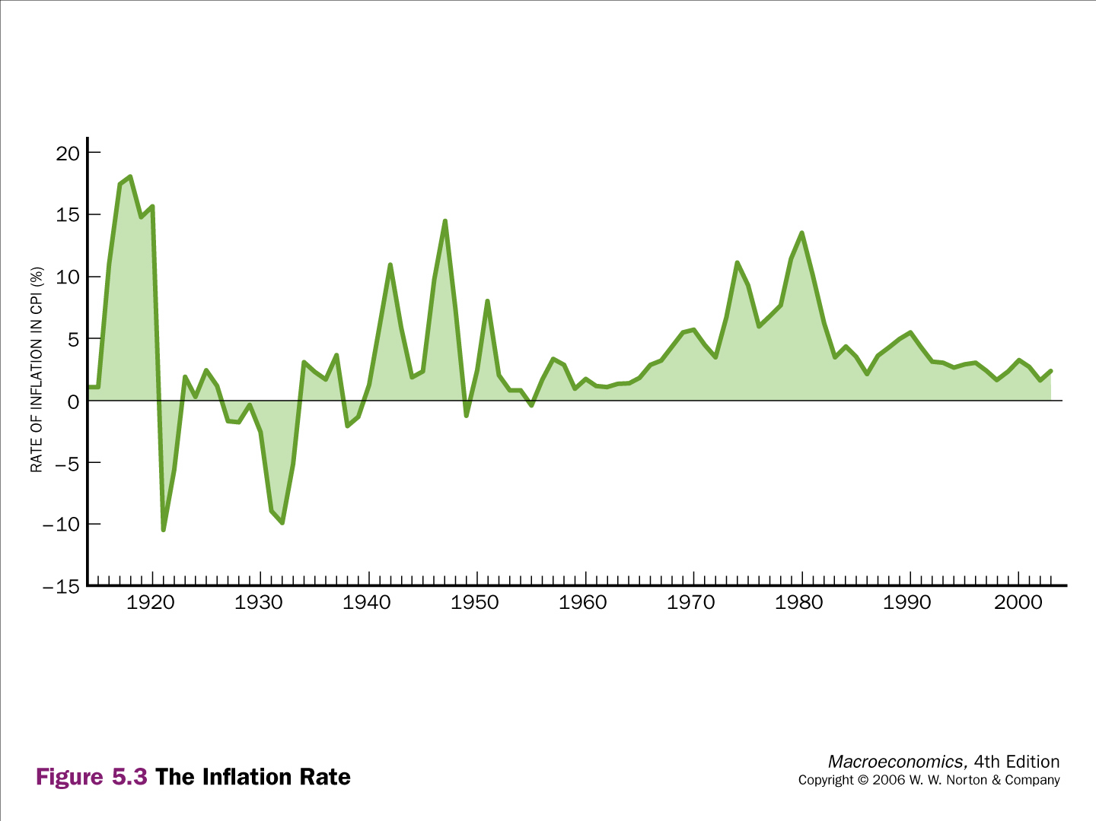
U.S. Inflation

Slide 18
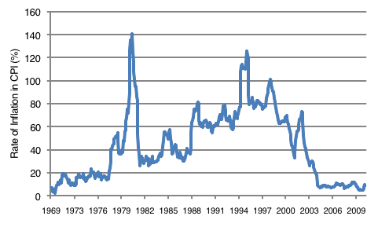
Turkish Inflation

Slide 19
How do we calculate the CPI?

Slide 20
How the Consumer Price Index Is Calculated
Fix the Basket: Determine what prices are most important to the typical consumer.
TÜİK identifies a market basket of goods and services the typical consumer buys.
They do regular consumer surveys to set the weights for the prices of goods and services.

Slide 21
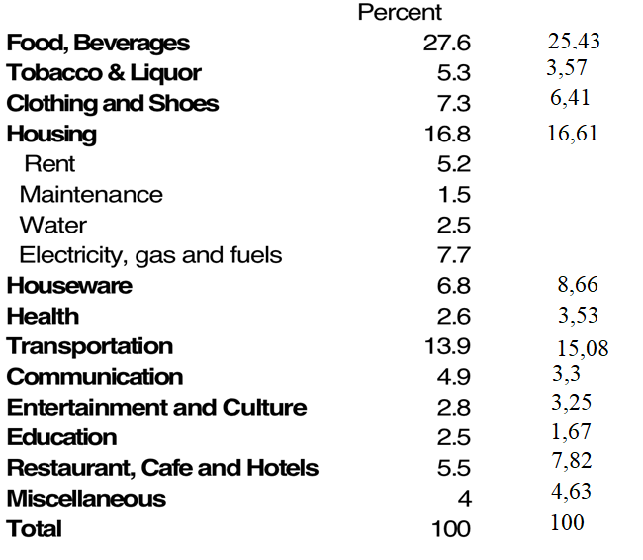
TUFE (Turkish CPI) weights: 2010 and 2023

Slide 22
US CPI weights
Notes:
This slide replicates Figure 24-1 from the text.
Source: Bureau of Labor Statistics, http://www.bls.gov/cpi/
This graph shows just a few highly aggregated categories. A more detailed breakdown is available at the BLS website: look for “Relative Importance of Components in the Consumer Price Index” there.

Slide 23
How the Consumer Price Index Is Calculated
Find the Prices: Find the prices of each of the goods and services in the basket for each point in time.

Slide 24
TUİK website
Kapsanan işlemler: TÜFE’de, yurtiçinde mal ve hizmet tüketmek amacıyla yapılan, tüm nihai parasal tüketim harcamaları esas alınmaktadır. Endekste tüm il merkezlerinden ve 74 ilçeden fiyat derlenmektedir. Ayda 27.500 işyerinden 375.000 fiyat derlenmekte ve 4252 kiracı endeks kapsamında takip edilmektedir.
Fiyat kapsamı: Endeksin fiyat kapsamı, satın alış fiyatları olarak tespit edilmektedir. Fiyatlar, vergiler dahil peşin ödemeler olarak belirlenerek, taksitli satışlar üzerinden fiyatlandırmalar veya anlaşmalı fiyatlar dikkate alınmamaktadır.

Slide 25
How the Consumer Price Index Is Calculated
Compute the Basket’s Cost: Use the data on prices to calculate the cost of the basket of goods and services at different times.

Slide 26
How the Consumer Price Index Is Calculated
Choose a Base Year and Compute the Index:
Choose a year as the base year, making it the benchmark against which other years are compared.
For Turkey currently the base year is 2003
To compute the index for any given year
divide the cost of the basket in that year by the cost in the base year
then multiply by 100.

Slide 27
How the Consumer Price Index Is Calculated
Compute the inflation rate: The inflation rate is the percentage change in the price index from the preceding period.

Slide 28

How the Consumer Price Index Is Calculated
The Inflation Rate
The inflation rate is calculated as follows:

Slide 29
Let’s make an example

Slide 30
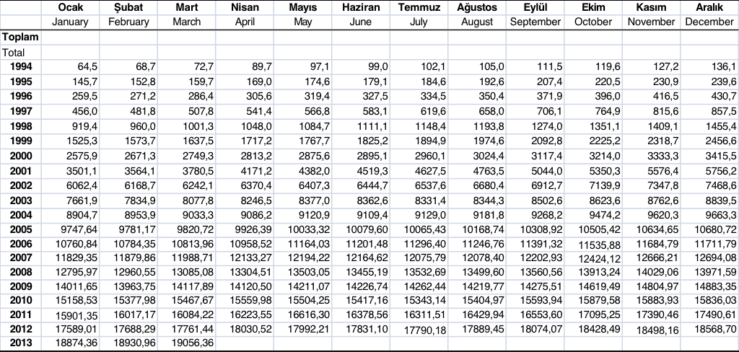
CPI (TÜFE) 1994 - 2013

Slide 31
Compute the yearly inflation (March 2012 to March 2013):
We need the CPI in March 2013
and
the CPI in March 2012.

Slide 32
CPI (TÜFE) 1994 - 2013

Slide 33
Compute the yearly inflation (March 2012 to March 2013):
CPI in March 2013 : 19056
CPI in March 2012 : 17761
CPI₂₀₁₃ - CPI₂₀₁₂ = 1295
(CPI₂₀₁₃ - CPI₂₀₁₂)/CPI₂₀₁₂ = 1295/17761
= 7,3%

Slide 34
Let’s do a bigger example

Slide 35
The typical consumer’s consumption basket: {4 wraps, 10 soda}
price of wrap
price of soda
year
cost of basket
2003
TL10
TL2.00
TL10 x 4 + TL2 x 10 = TL60
2004
TL11
TL2.50
TL11 x 4 + TL2.5 x 10 = TL69
2005
TL12
TL3.00
TL12 x 4 + TL3 x 10 = TL78
Compute CPI in each year:
2003: 100x(TL60/TL60) = 100
2004: 100x(TL69/TL60) = 115
2005: 100x(TL78/TL60) = 130
Inflation rate:
15%
13%
Notes:
Suggestion: Show students the data in the first three columns of the table. Before showing them the cost of basket calculations, tell them to take 3 minutes to compute the cost of the basket in each of the three years, and use those results to compute the value of the CPI in each of the three years. Then, show the rest of the slide.

Slide 36
Whose inflation rate is it anyway?

Slide 37
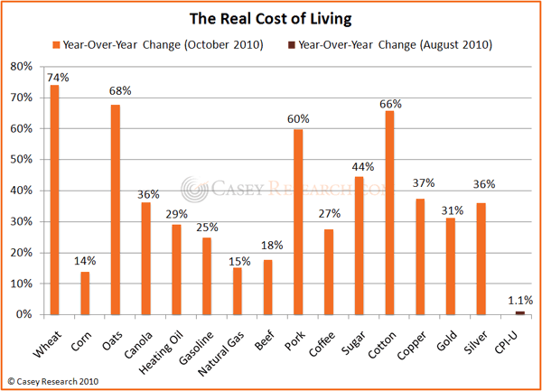
Do prices increase faster for low income households?

Slide 38
http://union.org.nz/economicbulletin126
Low income households have different spending patterns than high income households.
Low income households spend a larger fraction of budget on food.
The difference is even greater when we leave out non-alcoholic beverages, restaurant meals, and fast food.
Low income households spend more on “housing and household utilities”.
This includes rent and the cost of building new houses or extending existing houses.

Slide 39
A few facts and observations
Inflation

Slide 40
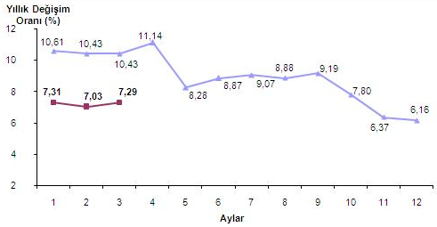
Yearly inflation rate TURKEY blue line 2012, red line 2013

Slide 41
Inflation in Turkey, as of the end of March 2013
The CPI increased by 7.29 percent (on same month of the previous year), on the previous month by 0.66 percent, on December of the previous year by 2.63 percent.
The highest annual increase was 16.31 percent in alcoholic beverages and tobacco. Housing (9.84 percent), hotels, cafes and restaurants (9.40 percent), food and non-alcoholic beverages (8.10 percent) were the other indices where high increases were recorded.
In March 2013 within average prices of 437 items in the index, the prices of 59 items remained unchanged while the prices of 246 items increased and for 132 items it decreased.

Slide 42
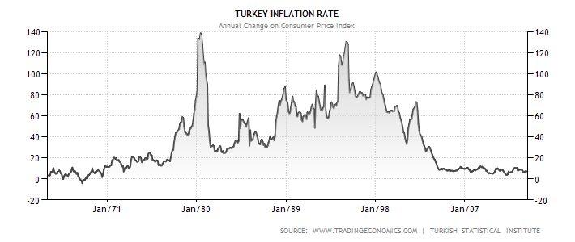
Inflation in Turkey, the last 50 years

Slide 43
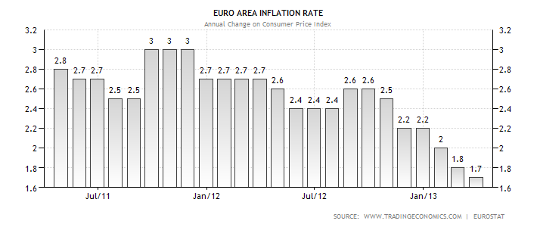

Slide 44
The Law of One Price
0
Law of one price: the notion that a good should sell for the same price in all markets
Suppose coffee sells for $4/pound in Seattle and $5/pound in Boston, and can be costlessly transported.
There is an opportunity for arbitrage, making a quick profit by buying coffee in Seattle and selling it in Boston.
Such arbitrage drives up the price in Seattle and drives down the price in Boston, until the two prices are equal.
Notes:
44

Slide 45
Purchasing-Power Parity (PPP)
0
Purchasing-power parity: a theory of exchange rates whereby a unit of any currency should be able to buy the same quantity of goods in all countries
based on the law of one price
implies that nominal exchange rates adjust to equalize the price of a basket of goods across countries
Notes:
45

Slide 46
Purchasing-Power Parity (PPP)
0
Example: The “basket” contains a Big Mac.
P = price of US Big Mac (in dollars)
P* = price of Mexican Big Mac (in pesos)
e = exchange rate, pesos per dollar
According to PPP,
e x P = P*
price of US Big Mac, in pesos
price of Mexican Big Mac, in pesos
P*
Solve for e:
e =
P
Notes:
46

Slide 47
PPP and Its Implications
0
PPP implies that the nominal exchange rate between two countries should equal the ratio of price levels.
If the two countries have different inflation rates, then e will change over time:
If inflation is higher in Mexico than in the U.S., then P* rises faster than P, so e rises – the dollar appreciates against the peso.
If inflation is higher in the U.S. than in Mexico, then P rises faster than P*, so e falls – the dollar depreciates against the peso.
P*
e =
P
Notes:
47

Slide 48
Limitations of PPP Theory
0
Two reasons why exchange rates do not always adjust to equalize prices across countries:
Many goods cannot easily be traded
Examples: haircuts, going to the movies
Price differences on such goods cannot be arbitraged away
Foreign, domestic goods not perfect substitutes
E.g., some U.S. consumers prefer Toyotas over Chevys, or vice versa
Price differences reflect taste differences
Notes:
48

Slide 49
Limitations of PPP Theory
0
Nonetheless, PPP works well in many cases, especially as an explanation of long-run trends.
For example, PPP implies: the greater a country’s inflation rate, the faster its currency should depreciate (relative to a low-inflation country like the US).
The data support this prediction…
Notes:
49
At this point in the textbook, there appears a graph (Figure 3) which shows Germany’s exchange rate during its interwar hyperinflation. The graph makes the point very clearly that, in this particular case, high inflation is accompanied by a similarly high depreciation.
For the sake of variety, and to show students that this relationship holds more generally, I show on the next slide a scatterplot of data on exchange rate depreciation and inflation rates for a cross-section of countries. The message is the same: the higher a country’s inflation rate, the greater will be the rate at which the country’s exchange rate depreciates.

Slide 50
Is the US the richest country in the world?
The US has the highest GDP per capita according to the PPP method.
Does it mean that the US is the richest country in the world?
Not exactly!
The US is by far the most unequal country in the developed world.

